Slide 1

PRESENTATION
COURSE CODE- IRE 211 COURSE TITLE-IOT ARCHITECTURE AND TECHNOLOGIES PRESENTATION TITLE- XMPP
TEAM- 3-WAY HANDSHAKE
PRESENTED BY:
1.IFTY IMAM BIN RAZZAK
ID:2101014
2.MD.SHAHIDUL ISLAM
ID:2101012
MD.ZUNAID HOSSAIN
ID:2101017
INSTRUTED BY:
SAURAV CHANDRA DAS
LECTURER
DEPARTMENT OF IRE,BDU

Slide 2
TABLE OF CONTENTS
1.WHAT IS XMPP? | "INTRODUCTION TO XMPP: A FOUNDATION FOR REAL-TIME COMMUNICATION"
2.ATTRIBUTES OF XMPP | "KEY ATTRIBUTES OF XMPP: WHAT MAKES IT UNIQUE?"
3.XMPP STANZAS | "XMPP STANZAS: BUILDING BLOCKS OF COMMUNICATION”
4.HOW XMPP WORKS | "UNDERSTANDING THE OPERATIONAL FLOW OF XMPP"
5.ESTABLISHING CLIENT-SERVER SESSIONS IN XMPP | "CONNECTING CLIENTS TO SERVERS IN THE XMPP ECOSYSTEM"
6.MESSAGE SENDING | "MECHANISMS OF REAL-TIME MESSAGING IN XMPP"
7.XMPP ARCHITECTURE | "UNDERSTANDING THE ARCHITECTURE OF XMPP”
8.XMPP IMPLEMENTATION STACK | “XMPP IMPLEMENTATION STACK”
9.FEATURES OF XMPP | "POWERFUL FEATURES OF XMPP"
10.EXAMPLE OF XMPP PROTOCOL IN ACTION | "PRACTICAL EXAMPLE: XMPP IN REAL-WORLD APPLICATIONS"
11.HOW TO INTEGRATE XMPP WITH OTHER PROTOCOLS | "XMPP INTEGRATION: BRIDGING WITH OTHER PROTOCOLS"
12.COMMON PROTOCOLS OF XMPP | "EXPLORING COMMON PROTOCOLS IN XMPP""
13.ADVANTAGES OF XMPP | "PROS AND CONS OF XMPP"
14.DISADVANTAGES OF XMPP | "PROS AND CONS OF XMPP"

Slide 3



XMPP
WHAT IS XMPP?
XMPP or eXtensible Messaging and Presence Protocol, is an open standard
( Publicly available without a license and can be used freely in commercial projects) communications protocol based on XML (Extensible Markup Language).

Slide 4


To get a better understanding of what XMPP can do, let's break down what exactly eXtensible Messaging and Presence Protocol means.
eXTENSIBLE
MESSAGING
PRESENCE
XMPP is an open-source project which can be changed or extended according to the need.
XMPP is designed for sending messages in real time. It has very efficient push mechanism compared to other protocols.
It determines whether you are online/offline/busy. It indicates the state.

Slide 5

ATTRIBUTES OF XMPP
It is used to build chat system.
It’s Decentralized.
It supports the Asynchronous exchange of data/information.
Transmits tiny pieces of the data instead of forwarding the big chunks directly.
It works over TCP.
Network configuration and components (hardware/software) has no role to play in the XMPP-based data transmission.
It is designed for Client-Server Model.
It uses 3 statuses, namely ‘offline’, ‘busy’, or ‘online’, to talk about the status of a user or network.
It transfers data back and forth between two end-points.

Slide 6

XMPP STANZAS
The most basic unit of communication in XMPP is called a stanza. there are 3 type of stanzas used in XMPP.
XMPP STANZAS
PRESENCE STANZA
MESSAGE STANZA
IQ STANZA
Presence Stanza is used to share Presence information between a client and the contacts of the clints (roaster).
Message Stanza is used to share chat messages between two parties.
IQ (Info/Query) Stanza is used to share information between XMPP server and the client.

Slide 7
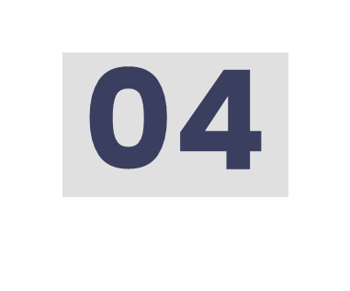
HOW XMPP WORKS
Client-Server Architecture:
XMPP uses a client-server model to send messages.
A message is sent to the XMPP server first, which then routes it to the correct recipient.
Unique Identifier (Jabber ID):
Every client has a unique ID called a Jabber ID (JID).
Format: user@domain.com/resource.
user: Username of the person.
domain.com: The domain of the XMPP server.
resource: Device type (optional, e.g., mobile or web).
Message Routing:
The server uses the JID to route messages to the right client.

Slide 8
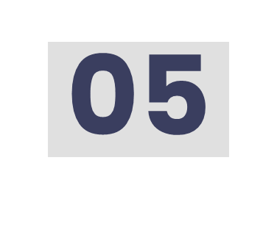
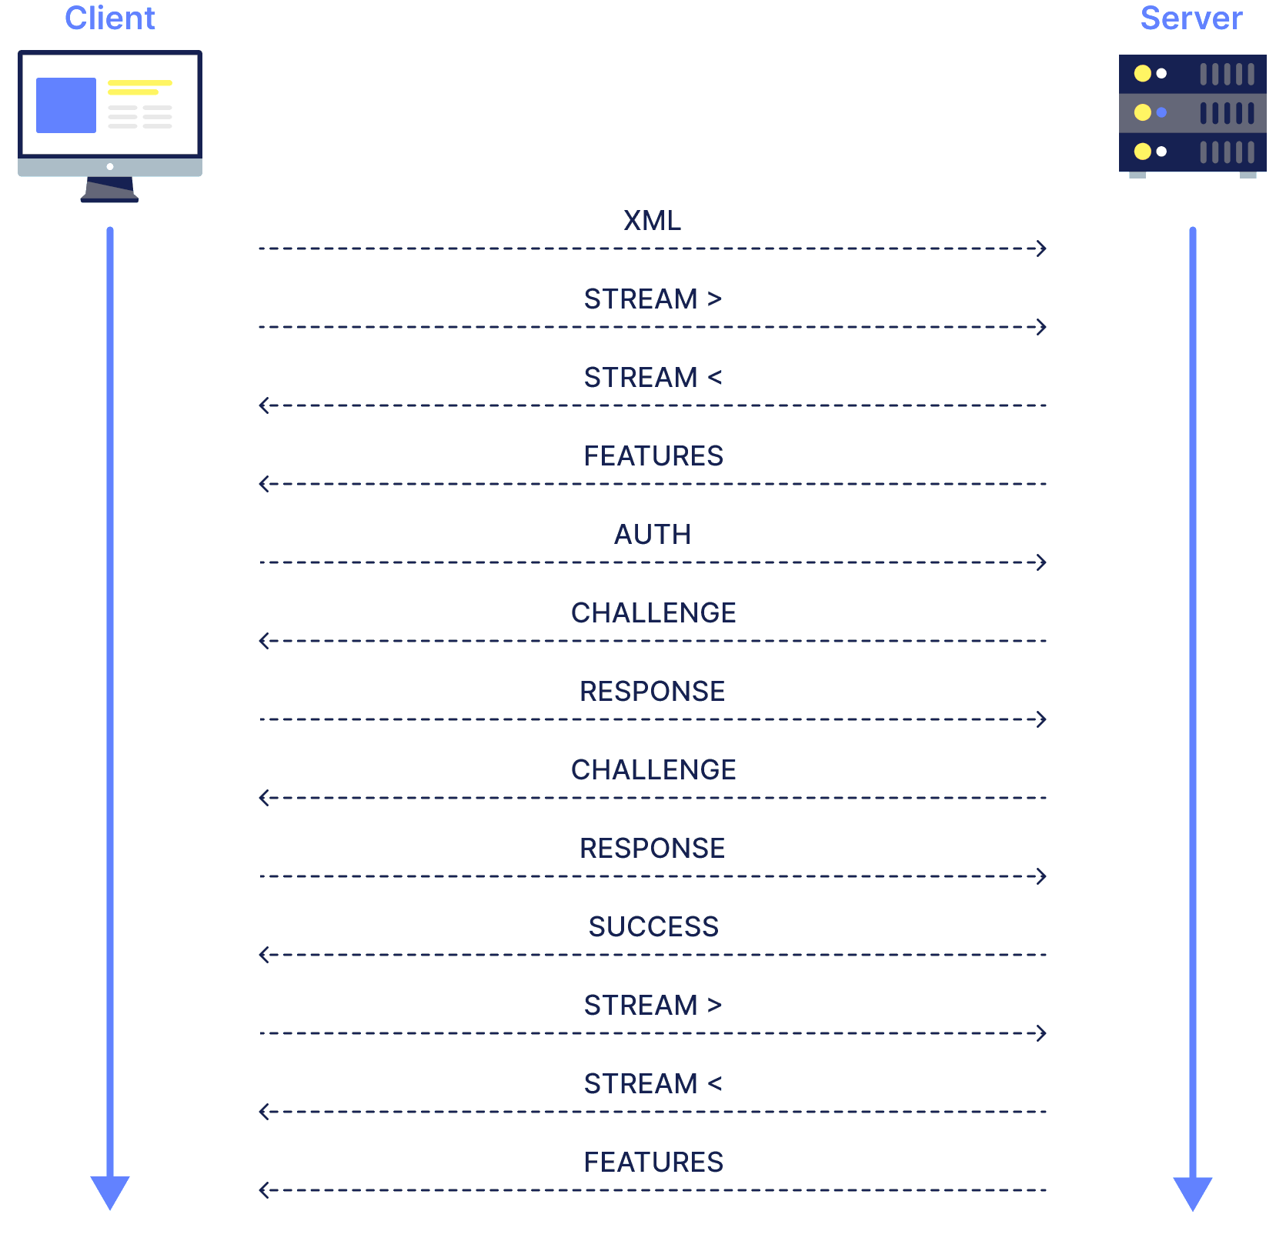
ESTABLISHING CLIENT-SERVER SESSIONS IN XMPP
The client opens a TCP Connection with the server.
After a TCP connection is established with the XMPP server, the Stream Negotiation And Authentication process begins.
This involves multiple packet exchanges between the client and server to set up the session.
Downside: The negotiation process adds latency, especially in poor network conditions with unstable connections and low bandwidth.

Slide 9
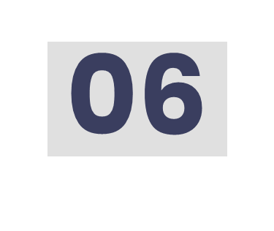
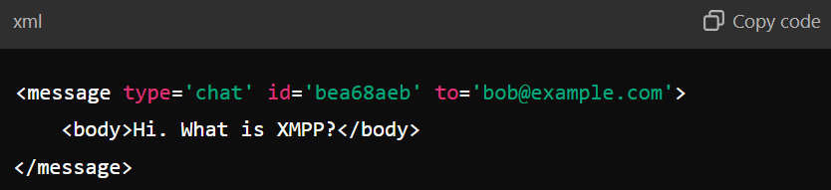
MESSAGE SENDING
Once a session is established, clients can send and receive messages.
Example of an XMPP message
This is an example of an XMPP Message Stanza, which is used for communication between clients in the XMPP protocol.

Slide 10
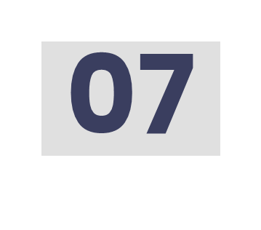
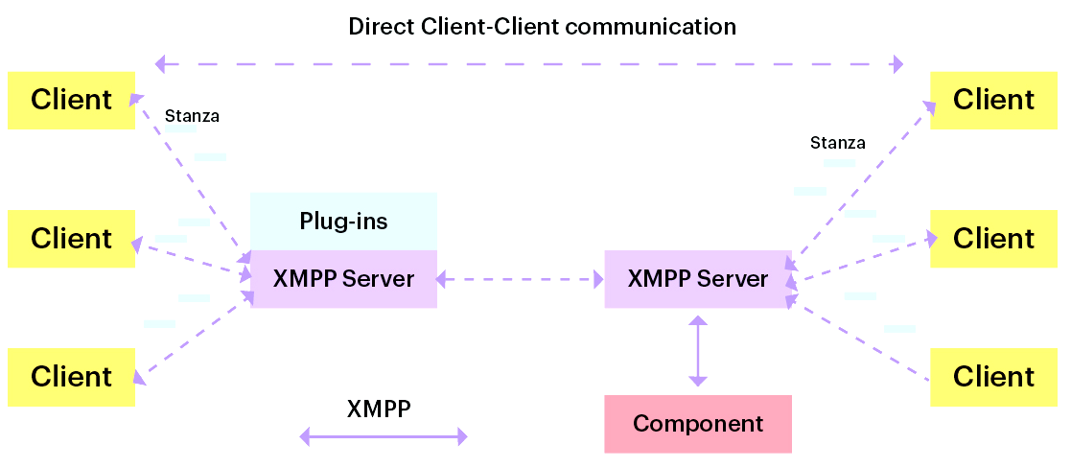
XMPP ARCHITECTURE
XMPP Architecture

Slide 11

XMPP IMPLEMENTATION STACK
Send Message
Resource Binding
SASL
TLS
TCP Connection
DNS Resolution
XMPP Core
https://xmpp.org/rfcs/rfc6120.html

Slide 12

KEY FEATURES OF XMPP
Asynchronous Messaging
Persistent Connection
Decentralization
Gateways
Multi-User Chat (MUC)
File Transfer
Publish-Subscribe (PubSub)
Presence Subscription
End-to-End Encryption
Additional Features:
Instant Messaging: Transfer messages between two users.
Delivery Receipts: Confirm message delivery.
Typing Indicators: Show when someone is typing.
Message Archive Management: Store and retrieve past messages.
User Permissions: Manage access within group channels.

Slide 13




XMPP PROTOCOL EXAMPLES
XMPP enjoys the reputation of a core element for many communication apps that we use presently. Some of the most famed apps, developed using XMPP, are as mentioned below.
WhatsApp is built using a proprietary XMPP.
The amazing chat capability of Zoom is all because of XMPP.
For instant push notification delivery, Apple uses XMPP both in the iPhone and Mac.
For development of highly functional chat apps, XMPP is one of the multiple choices offered. However, it continues to grow as a preferred one for many because of its distinctive features and multiple benefits that it brings on the table.

Slide 14

COMMON PROTOCOLS OF XMPP
XMPP is a widely used protocol for real-time communication, particularly in instant messaging, voice-over IP, and social networking applications. Here are some of the common XMPP protocols:
1. XMPP Core:
Defines the basic structure, messaging, presence, and roster management in XMPP.
2. XMPP IM:
Handles instant messaging features like message sending, acknowledgments, and buddy lists.
3. XMPP Presence:
Manages user availability status (online, offline, busy, etc.) and activity sharing.
4. XMPP MUC:
Enables group chats with features like room moderation, roles, and presence updates.

Slide 15
COMMON PROTOCOLS OF XMPP
5. XMPP PubSub:
Facilitates publishing and subscribing to data streams or notifications.
6. XMPP File Transfer:
Standardizes secure file sharing via in-band or out-of-band methods.
7. XMPP Jingle:
Supports negotiation and transport for voice and video calls over XMPP.
8. XMPP XEPs:
Adds functionalities like encryption, geolocation, and avatars through extensions.

Slide 16

HOW TO INTEGRATE XMPP WITH OTHER PROTOCOLS
Integrating XMPP with other protocols can enhance the functionality and versatility of your software. By enabling communication and data exchange between XMPP and other protocols, you can create seamless user experiences and improve interoperability.
Gateway or Transport Integration: Create a bridge between XMPP and other protocols (e.g., IRC, SMS) for cross-platform communication.
Protocol Bridging Libraries: Use libraries like Smack to simplify and unify interactions between XMPP and other protocols.
Webhooks and APIs: Leverage webhooks or APIs to send and receive data, enabling real-time interaction between XMPP and external systems.

Slide 17
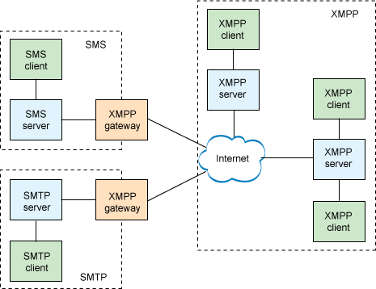
HOW TO INTEGRATE XMPP WITH OTHER PROTOCOLS

Slide 18

BENEFITS OR ADVANTAGES OF XMPP PROTOCOL
Following are the benefits or advantages of XMPP protocol:
➨Extensible : It can be customized to individual user requirements.
➨Messaging : Short messages are used for fast communication between user and server.
➨Presence : It is reactive to presence of user and his/her status.
➨Protocol : It is an open platform which is constantly evolving.
➨Secured : It uses TLS and SASL to provide secured end to end connection.
➨It offers persistent connection.
➨It is decentralized in nature as no central XMPP servers are needed.
➨It allows servers with different architectures to communicate.

Slide 19

DRAWBACKS OR DISADVANTAGES OF XMPP PROTOCOL
Following are the drawbacks or disadvantages of XMPP protocol:
➨It does not have QoS mechanism as used by MQTT protocol.
➨Streaming XML has overhead due to text-based communication compare to binary based communication.
➨XML content transports asynchronously.
➨Server may overload with presence and instant messaging.

Slide 20
QUESTION 01
A company has implemented a real-time communication system using a protocol based on a client-server architecture. In this system:
Each user is assigned a unique identifier in the format user@domain.com/resource to enable message routing.
Messages are sent by the client to the server, which then routes them to the intended recipient.
The architecture supports server-to-server communication, allowing users on different domains to exchange messages.
To initiate communication, clients establish a persistent TCP connection with the server. Once connected, the protocol uses structured XML streams for communication, ensuring that data is transmitted efficiently.
Questions:
How does the client-server architecture of this protocol enable reliable message delivery and routing? Explain the role of unique identifiers (user@domain.com/resource) in this process. (9 Marks)
Describe the advantages of server-to-server communication in this protocol. How does it enable scalability and decentralization across multiple domains? (9 Marks)

Slide 21
QUESTION 02
A team is developing a communication platform for a multinational company. The platform must support features such as real-time messaging, group chats, file sharing, and video calls between users. The system uses a protocol that enables asynchronous messaging, decentralization, and persistent TCP connections for efficient communication.
For text and file-based interactions, the protocol uses unique identifiers for each user and manages message delivery through a client-server architecture. Additionally, for video calls, the system leverages XML stanzas for session negotiation and employs extensions to handle voice and video data securely using encryption mechanisms.
Questions:
Which protocol is most likely being used for this communication platform? Explain how its features like persistent connection, multi-user chat, and file transfer make it suitable for real-time messaging and group collaboration. (9 Marks)
How does this protocol handle video and voice communication? Describe the role of session negotiation, XML stanzas, and encryption in ensuring seamless and secure calls. (9 Marks)

Slide 22


REFERENCES
https://www.geeksforgeeks.org/xmpp-protocol/
https://xmpp.org/about/faq/
https://www.cometchat.com/blog/xmpp-extensible-messaging-presence-protocol
https://www.pubnub.com/guides/xmpp/
https://sceyt.com/blog/xmpp-extensible-essaging-and-presence-protocol
https://www.wallarm.com/what/extensible-messaging-presence-protocol

Slide 23

QUESTIONS?

Slide 24

THANKS!

